Slide 1
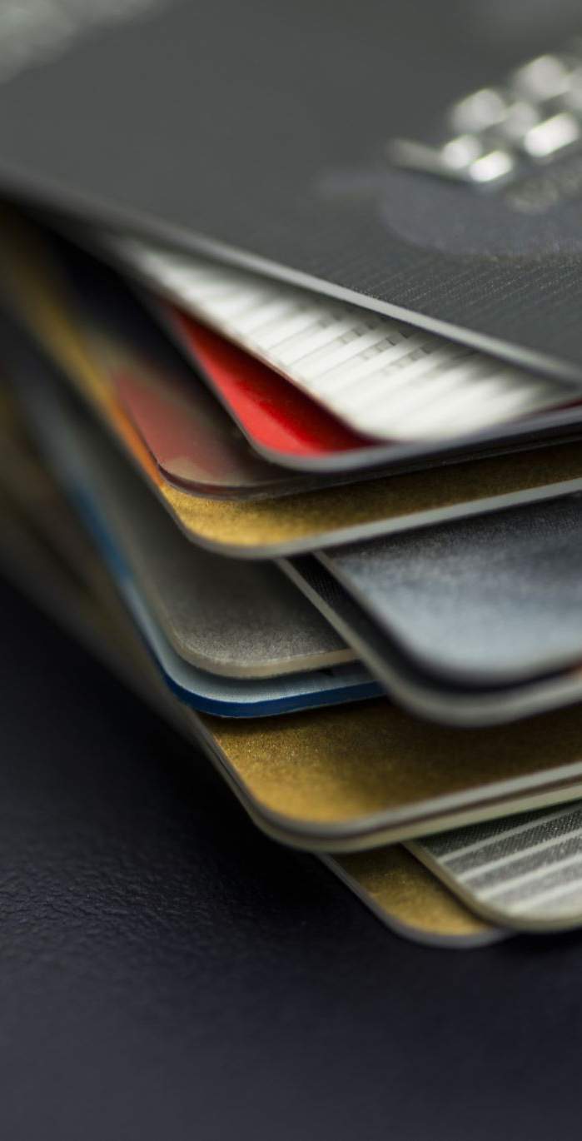

Credit Card Customer Churn Prediction
Maxim Bilenkin
DSC 680 - Applied Data Science
Milestone 3
Spring 2026

Slide 2
Business Problem
• Banking industry is highly competitive
• Customer acquisition is expensive
• Losing customers reduces long-term revenue
• Goal: Predict and prevent customer churn

Slide 3
Why It Matters
• Retention is cheaper than acquisition
• Helps improve customer loyalty
• Enables targeted marketing strategies

Slide 4
Background
• Customer churn = customers leaving the bank
• Caused by dissatisfaction, competition, or low usage
• Machine learning helps predict churn patterns

Slide 5
Dataset
• BankChurners dataset
• 10,127 customers
• 23 features
• Includes demographics + transaction behavior

Slide 6
Data Preparation
• Removed Naive Bayes columns (data leakage)
• No missing values
• Encoded categorical variables
• Target variable: 0 = Existing, 1 = Churned

Slide 7
Methods
• Logistic Regression
• Random Forest
• Evaluation:
- Accuracy
- ROC-AUC
- Confusion Matrix

Slide 8
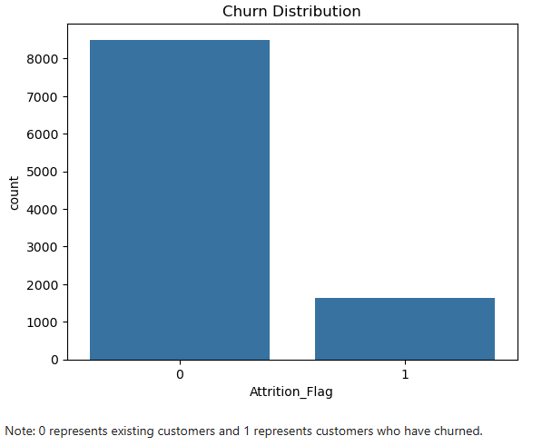
Churn Distribution
• Dataset is imbalanced
• ~84% existing customers
• ~16% churned customers

Slide 9
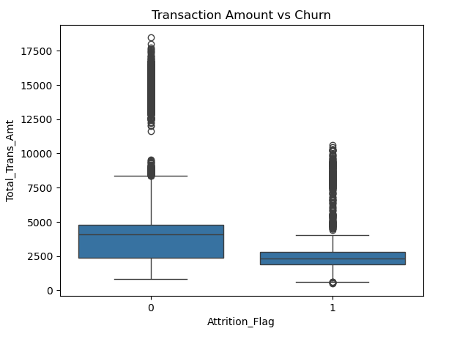
Transaction Behavior
• Churned customers spend less
• Lower engagement = higher churn risk

Slide 10
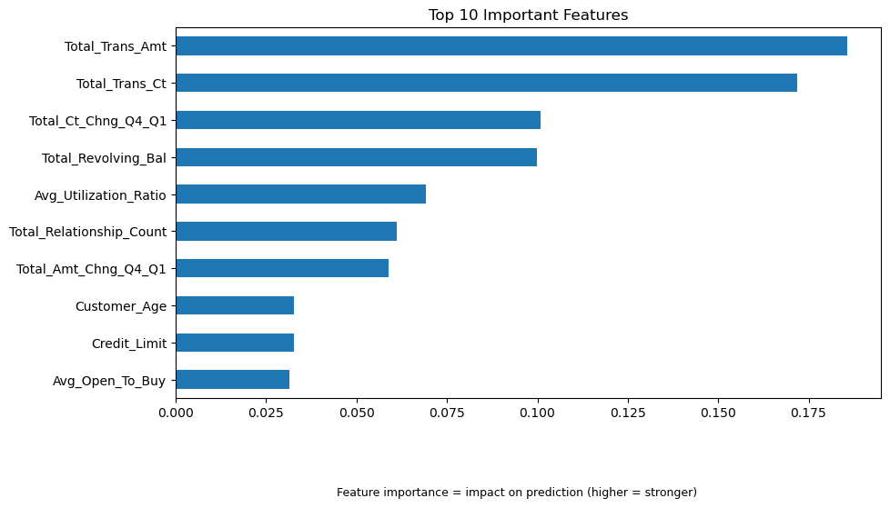
Feature Importance
Top Drivers:
• Total Transaction Amount
• Total Transaction Count
• Transaction change behavior

Slide 11
Model Results
• Logistic Regression: ~86% • Random Forest: ~95.5% • ROC-AUC: ~0.987

Slide 12
Key Insights
• Customer activity drives churn
• Low usage = high risk
• Demographics have low impact

Slide 13
Recommendations
• Target low-activity customers
• Improve rewards (cashback)
• Enhance customer experience
• Monitor spending behavior

Slide 14
Future Uses
• Apply to loans and other products
• Real-time churn prediction
• Expand to other industries

Slide 15
Ethical Considerations
• Avoid bias in predictions
• Ensure fair treatment
• Use data responsibly

Slide 16
Q&A
Questions?

